Slide 1
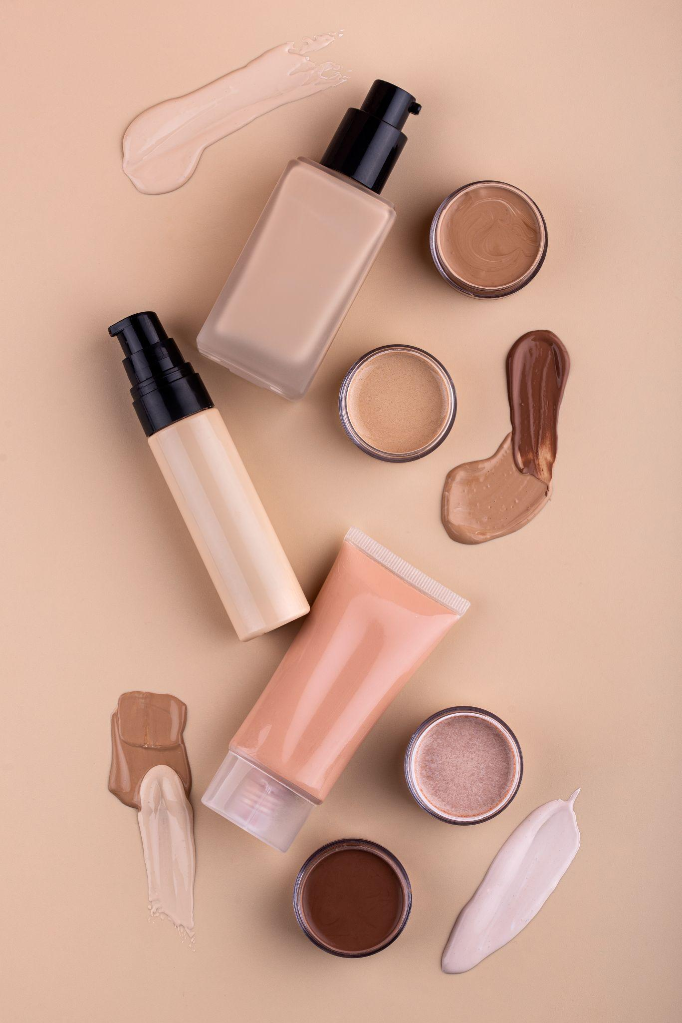

Midshi Cosmetic Shop
Ishita S Savera
22030501046
MCA Semester-4
Internal Guide : Prof. Nidhi Chitroda
Darshan University

Slide 2
Outline
Introduction
Project Profile
Abstract
Advantages
Use Languages
Day Sheduling
Data Dictionary
Screen Shorts

Slide 3
Acknowledgment
I am the student of M.C.A studying in the Darshan University. Thanks the entire person who has landed their support in shaping of the systemic.
I have great deal of gratitude towards our Head of Department who encourage us in taking up this activity. I thank all faculties and administrative staff of the institute in enhancing their cooperation.
I thank Prof. Nidhi Chitroda before giving us full guidance and cooperation in understanding the system. I also thank them for their unconditional help in making of this project.

Slide 4
Project Profile
Developed By | Ishita S Savera
Operating System | Microsoft Windows 11
Editor | Subline , Visual Studio Code
Web Server | Xampp
Web Browser | Internet Explorer 6.0, Mozilla , Firefox, Google Chrome , Opera.
Guided By | Prof. Nidhi Chitroda

Slide 5
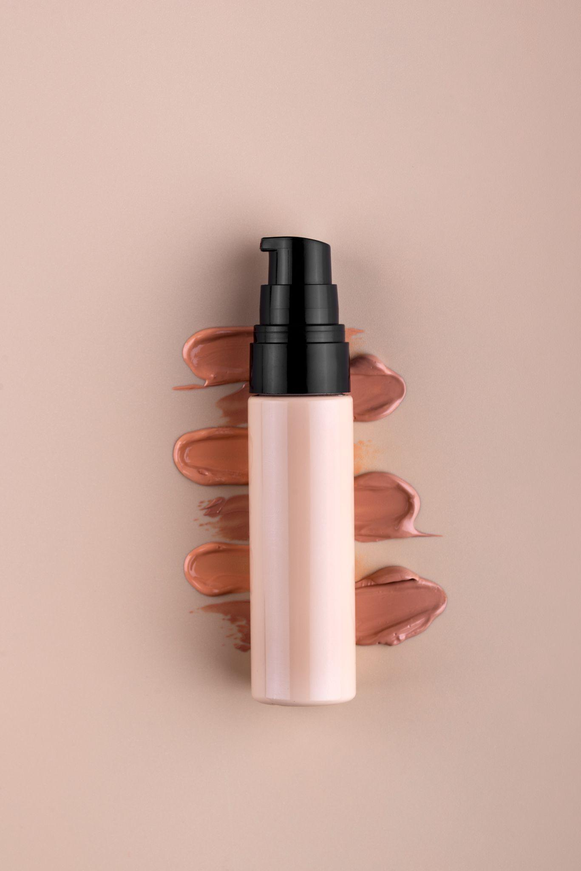
Abstract
A cosmetic shop serves as a retail space where customers can purchase a variety of beauty and personal care products. The primary purpose of a cosmetic shop is to provide consumers with a convenient and dedicated space to explore, try, and purchase a wide range of cosmetic items.

Slide 6
Advantages
Product
Information:
Comparison Shopping:
Special Discounts and Promotions:
Online platforms often provide detailed product descriptions, ingredient lists, and customer reviews, helping customers make informed decisions about their purchases.
Consumers can easily compare prices, features, and reviews of different products and brands, enabling them to find the best value for their money.
Online cosmetic shops frequently offer exclusive discounts, promotions, and loyalty programs, allowing customers to save money on their favorite products.

Slide 7
Use Language And Framework
PHP
HTML
CSS
Bootstrap
JS

Slide 8
Implementation Process
6
Maintenance
1
Planning
5
Testing
2
Analysis
4
Implementation
3
Design

Slide 9
Module List
Show Category
Show Product
Order Product
Payment
Add Category
Add Product
Delete Product
Delete Category

Slide 10
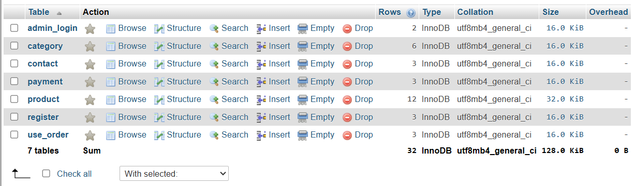
Data Dictionary

Slide 11
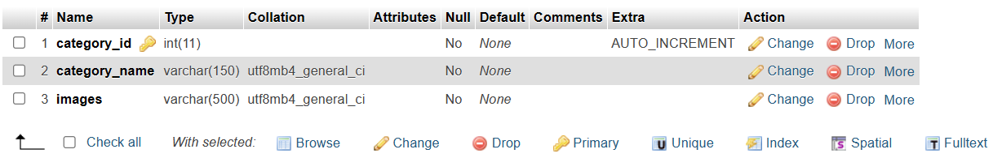
Category

Slide 12
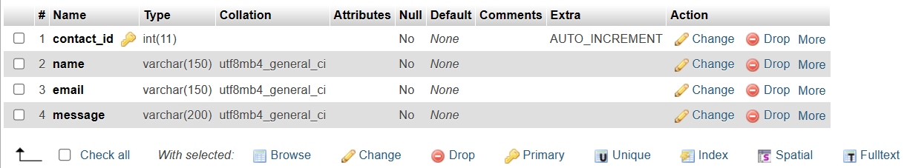
Contact

Slide 13
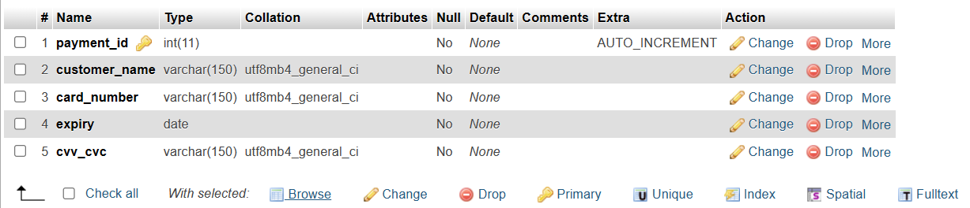
Payment

Slide 14
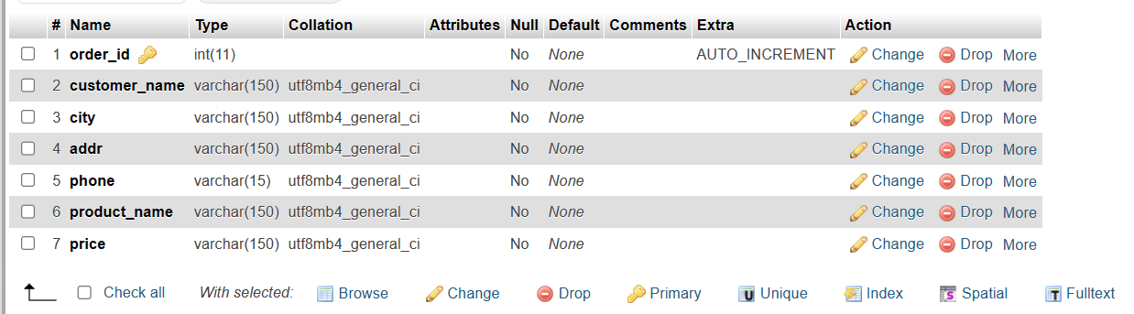
Order

Slide 15
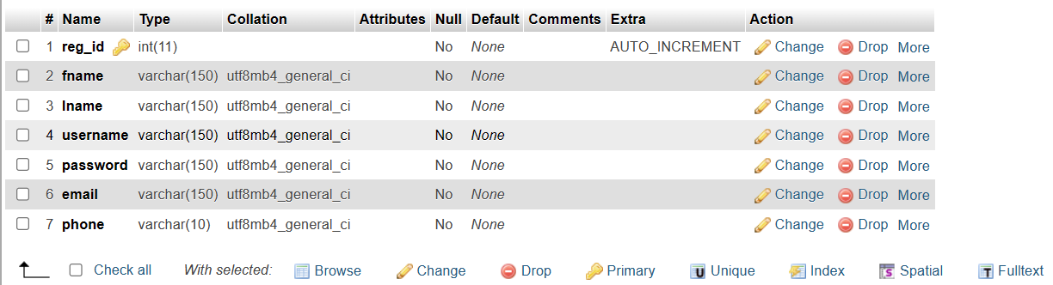
Register

Slide 16
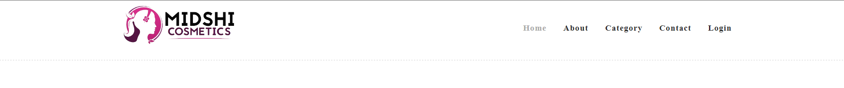
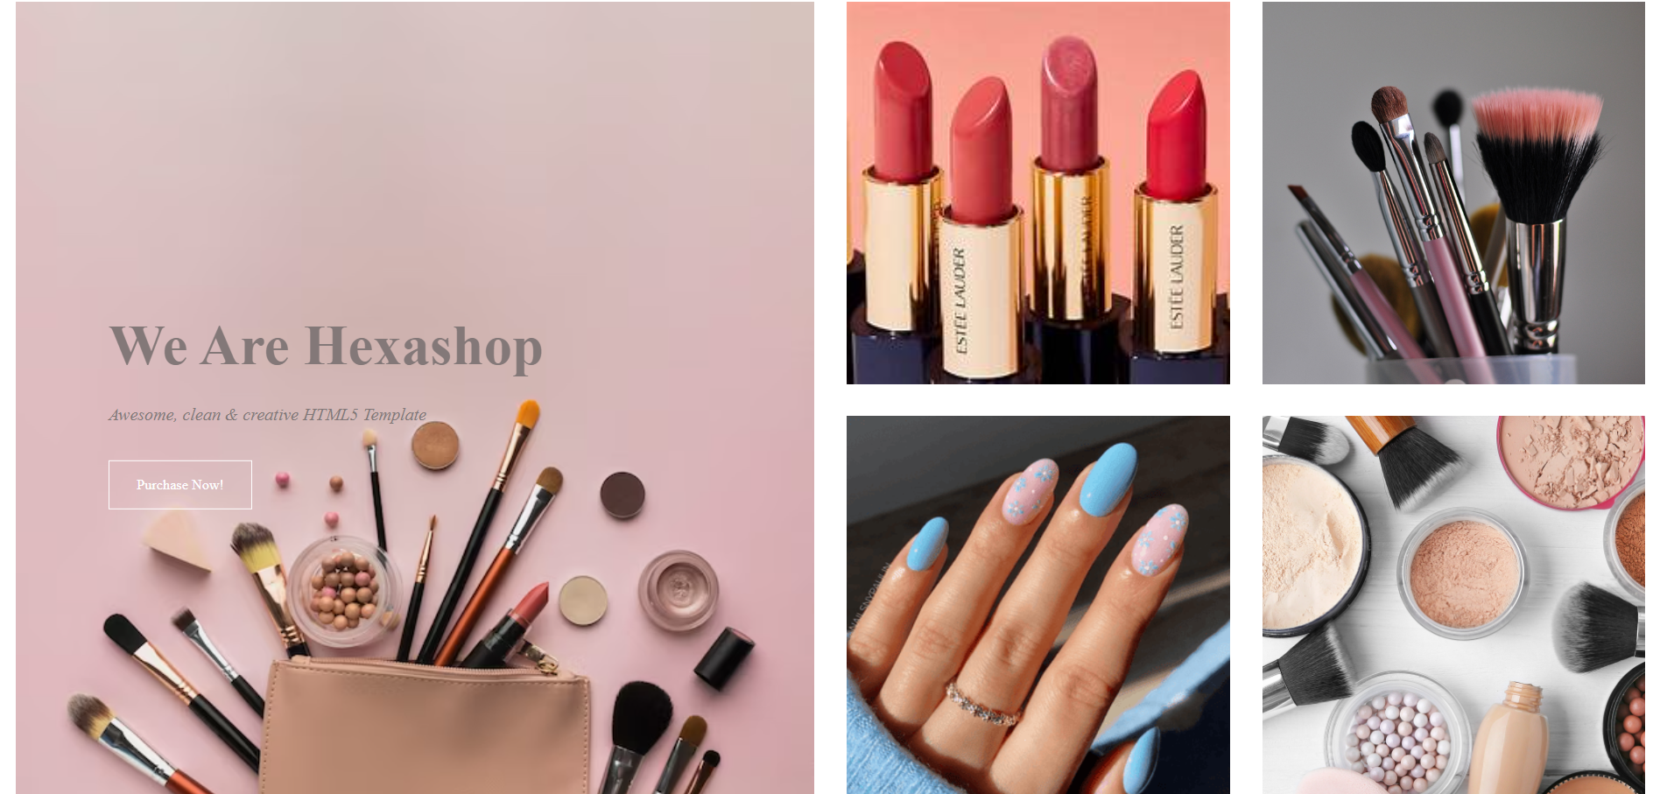
Home

Slide 17
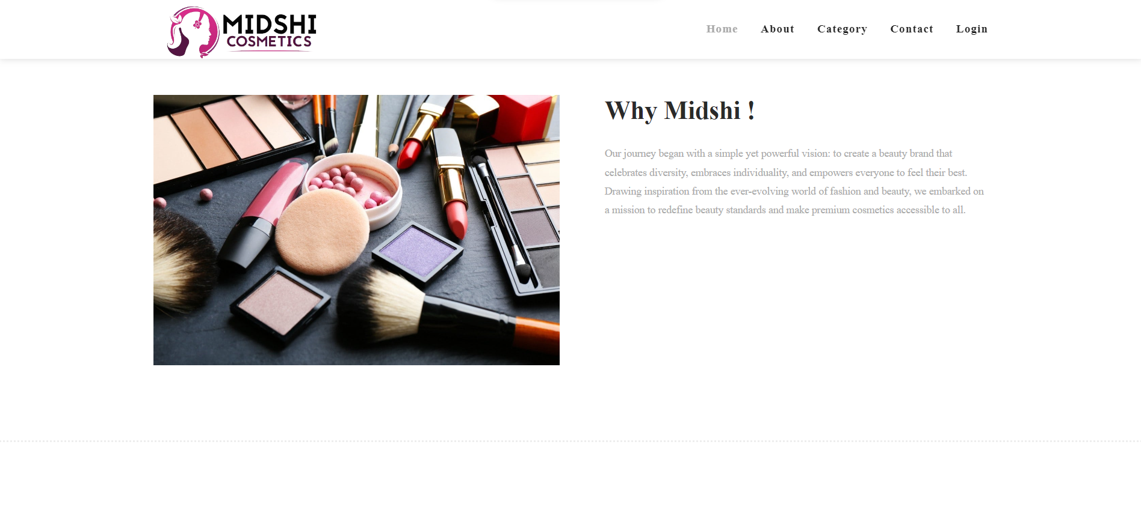
About

Slide 18
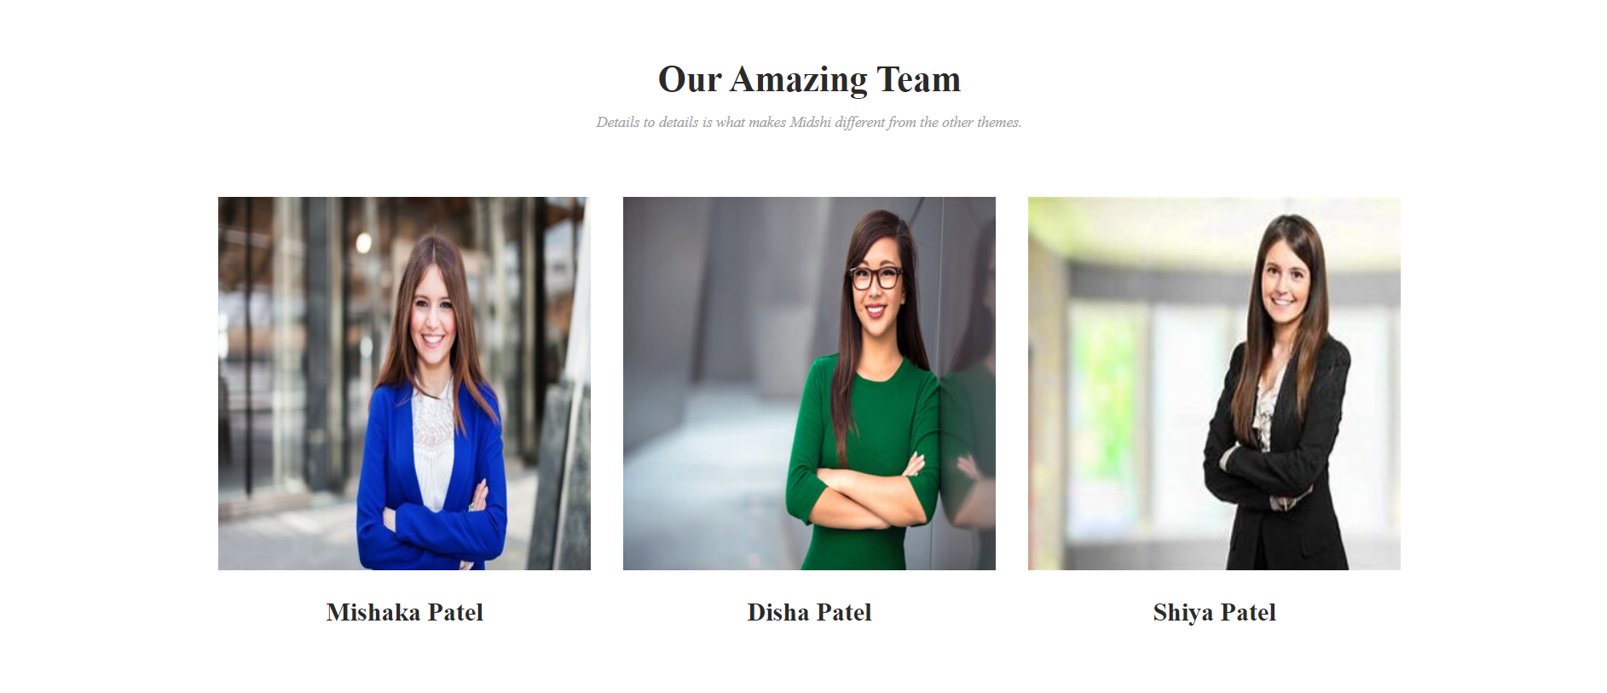
Our Team

Slide 19
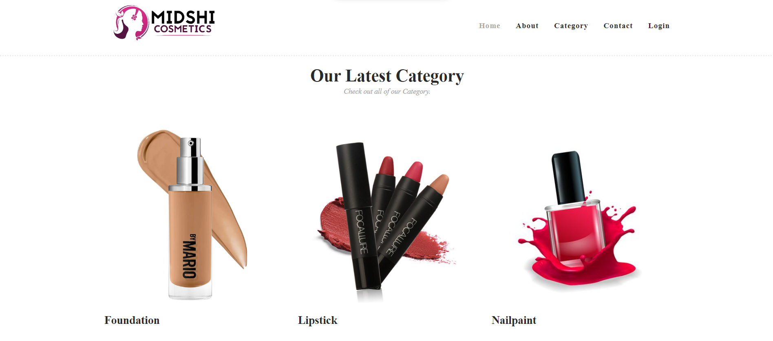
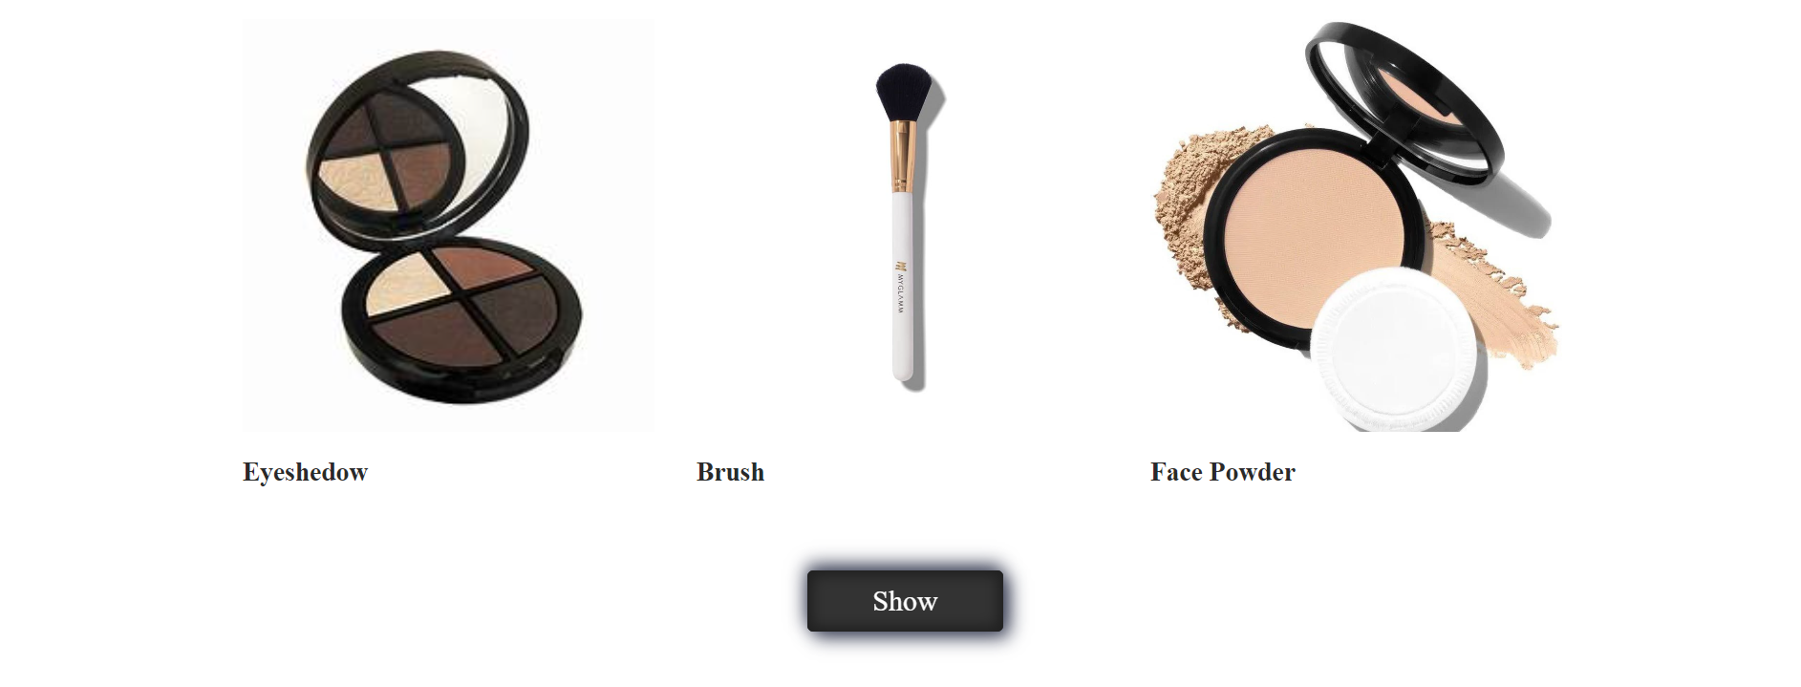
Category

Slide 20
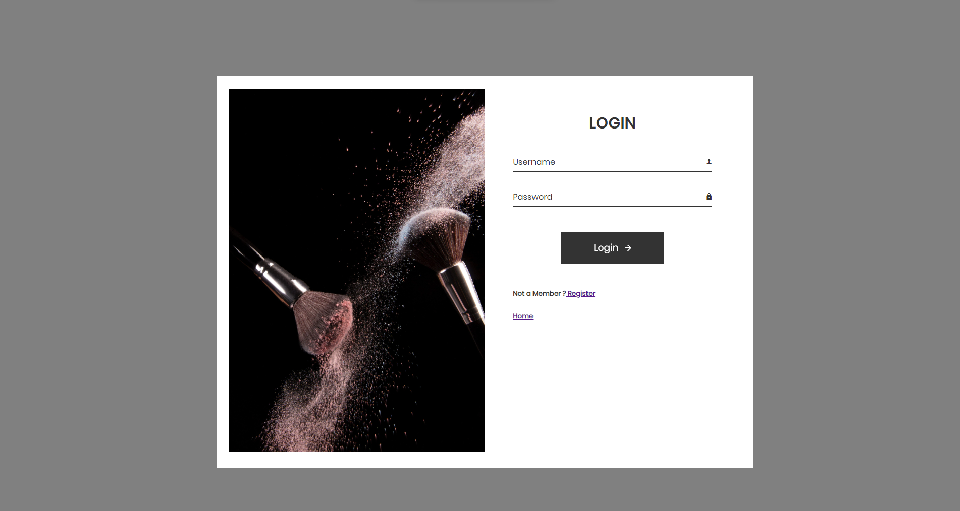
Login Form

Slide 21
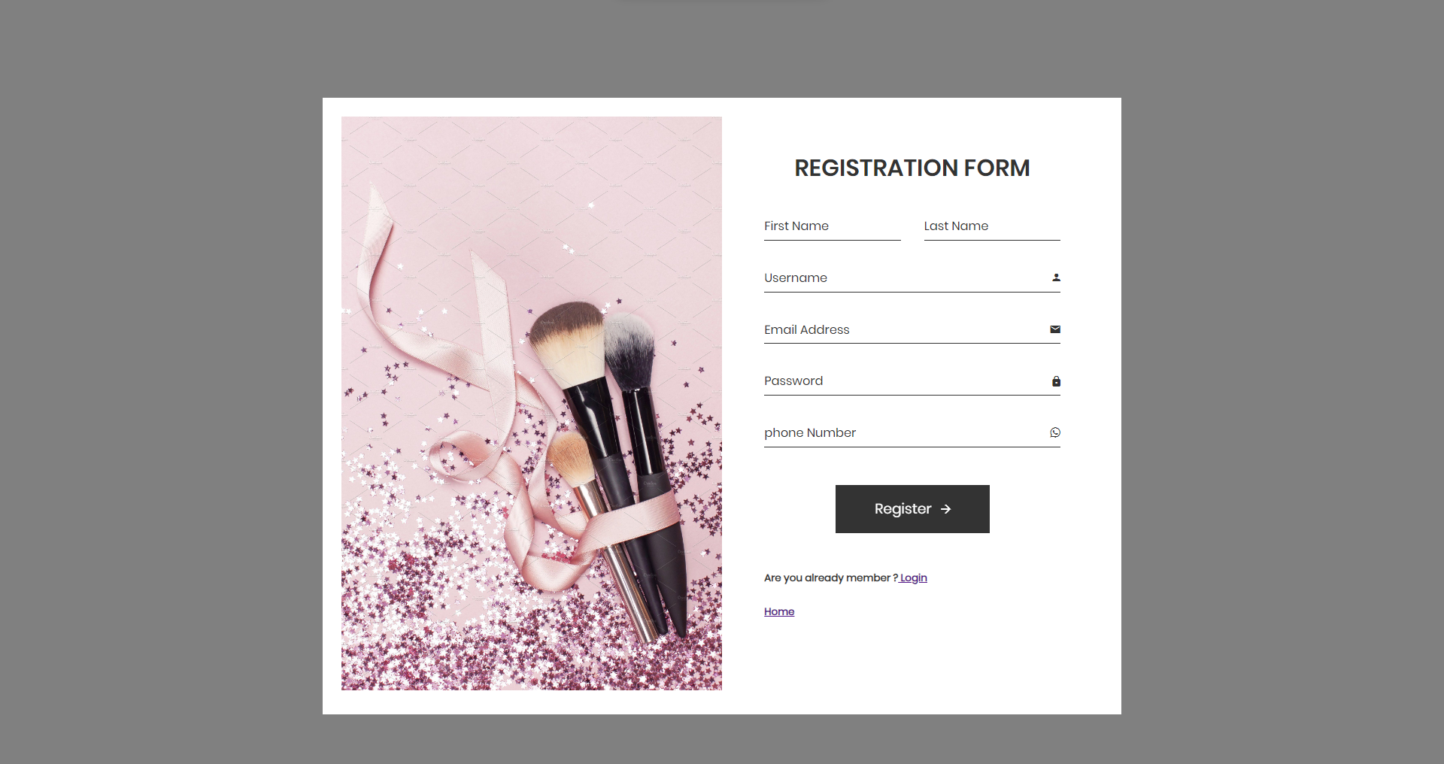
Registration Form

Slide 22
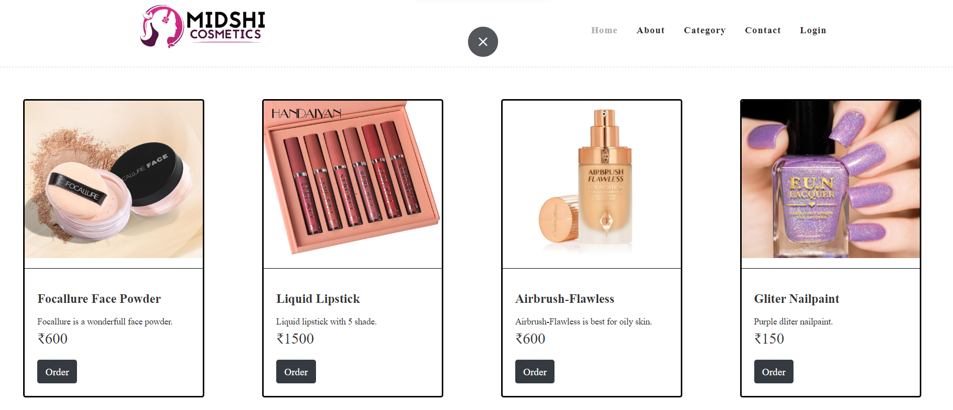
Product

Slide 23
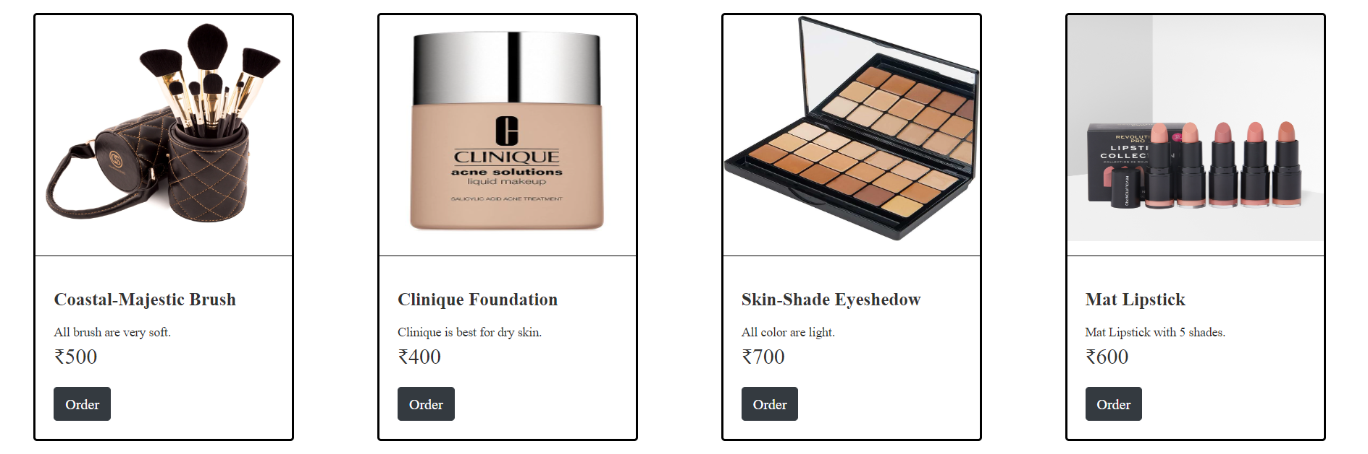
Product

Slide 24
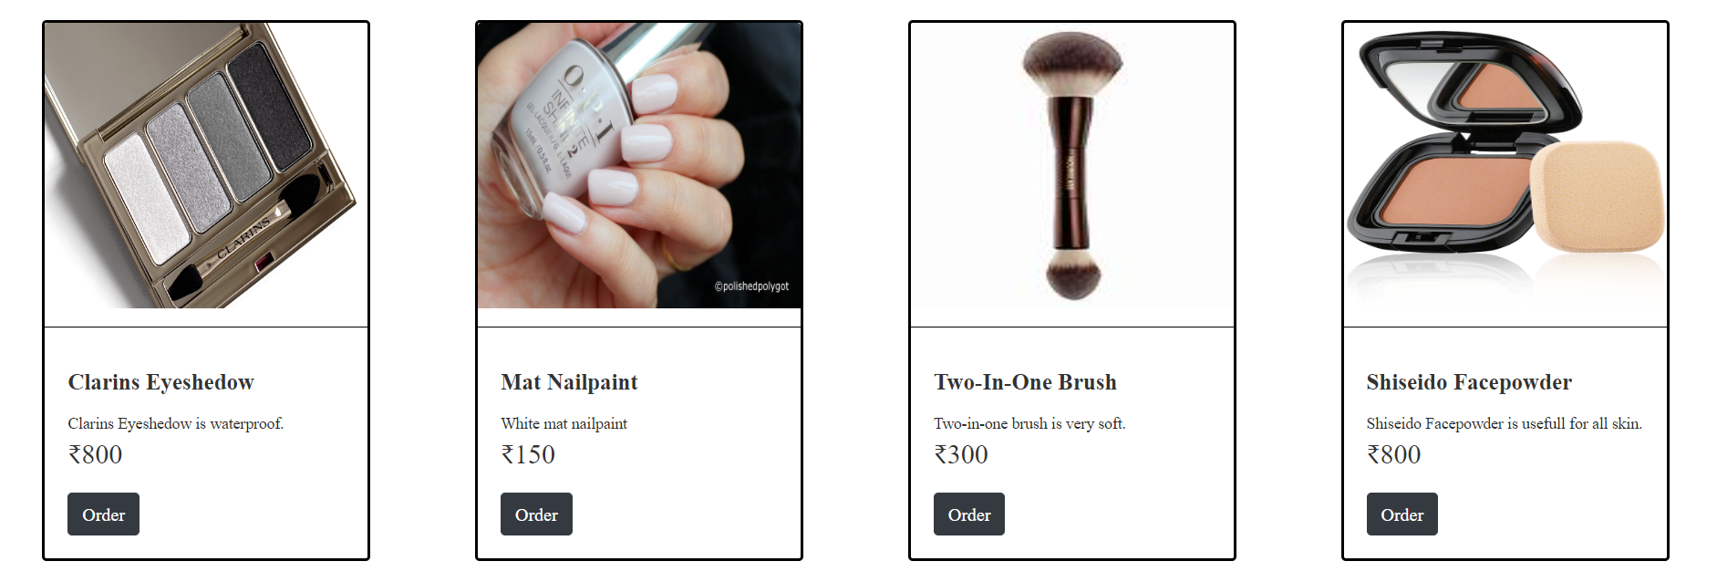
Product

Slide 25
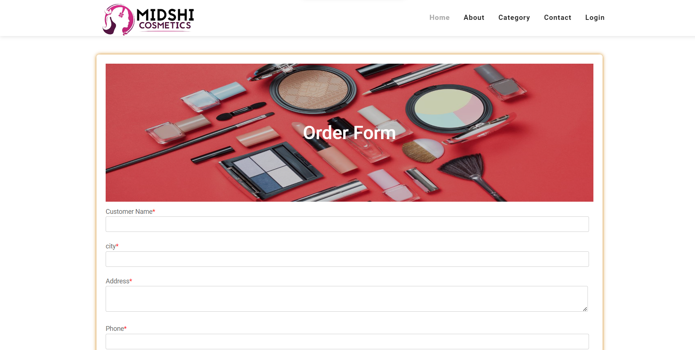
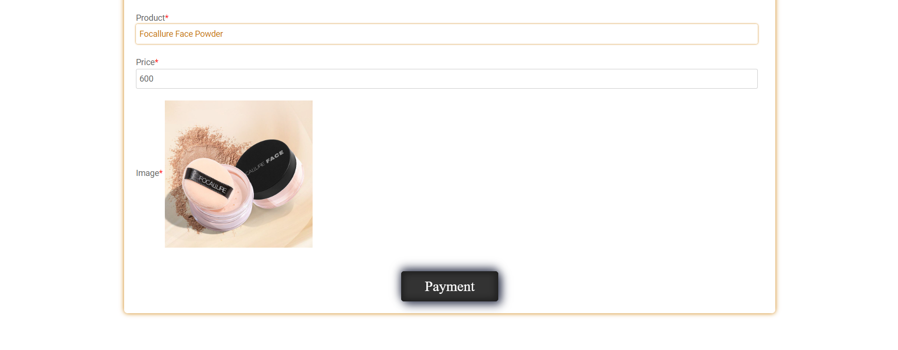
Order

Slide 26
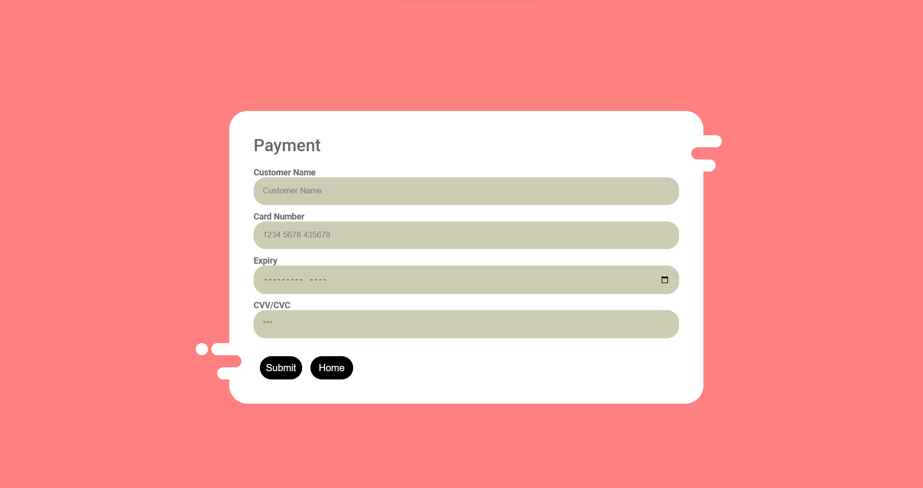
Payment

Slide 27
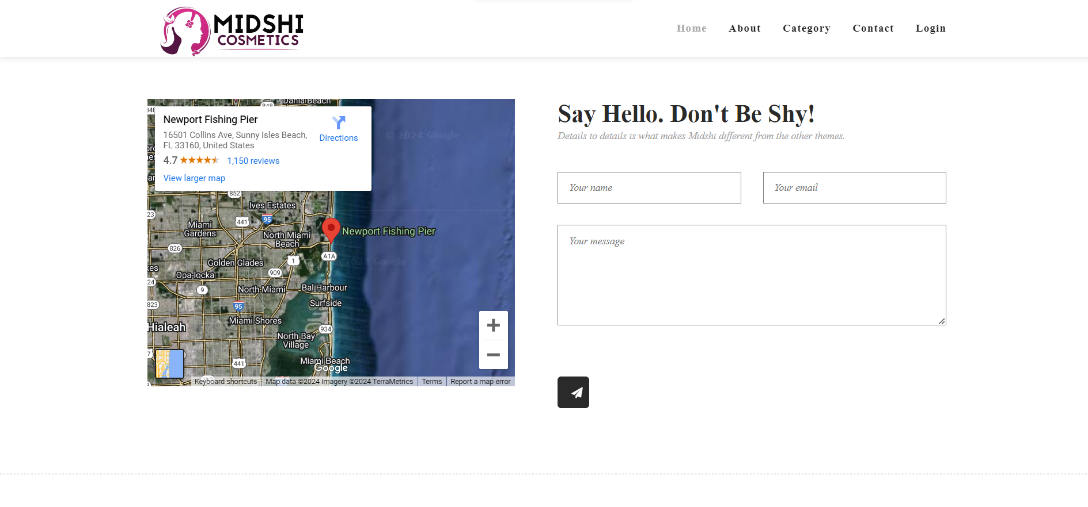
Contact

Slide 28
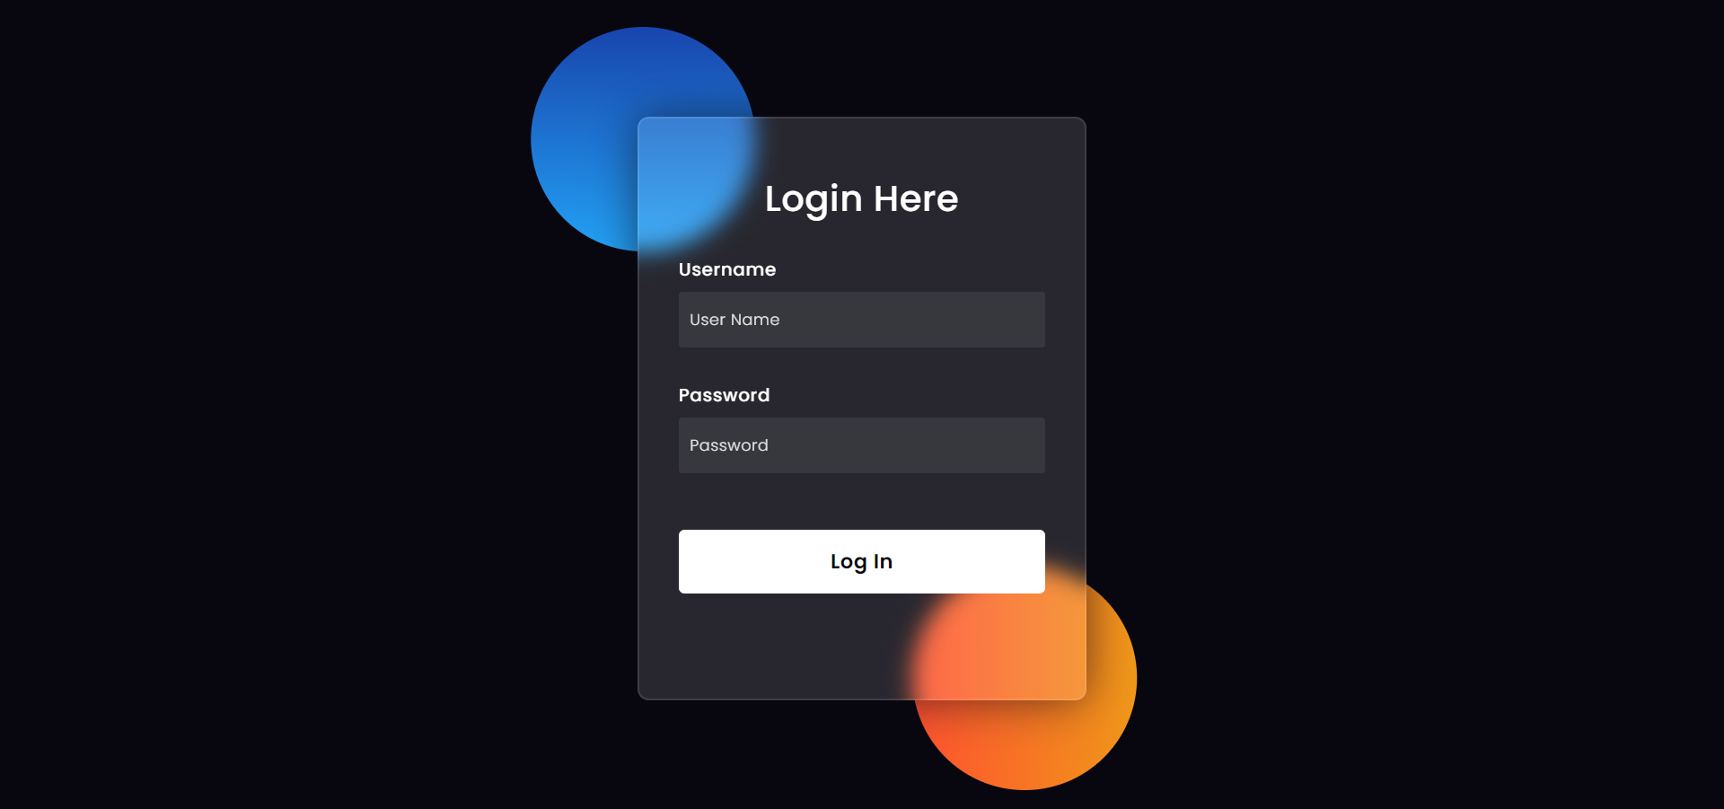
Login Form

Slide 29
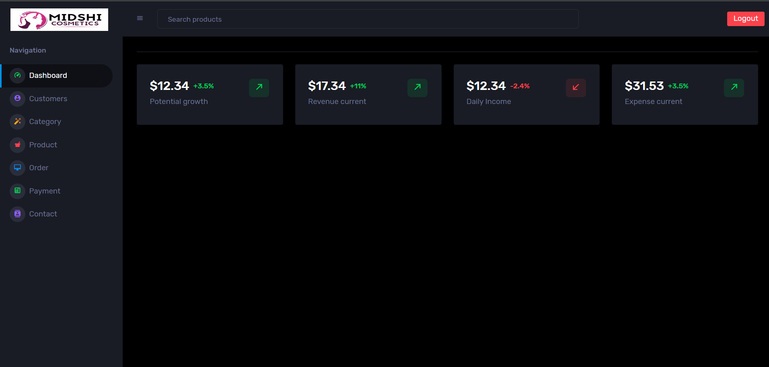
Dashboard

Slide 30
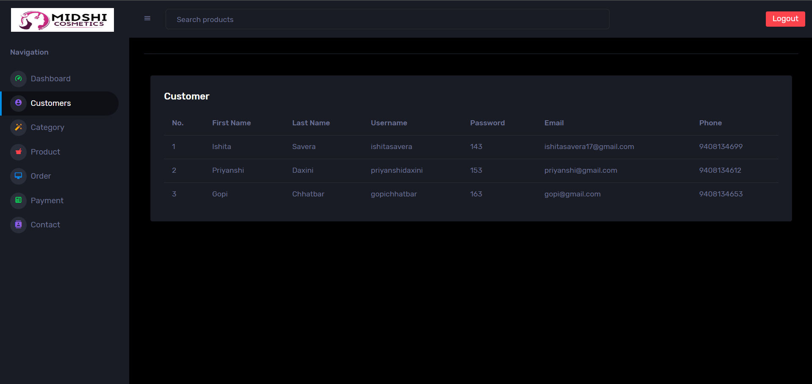
Customer

Slide 31
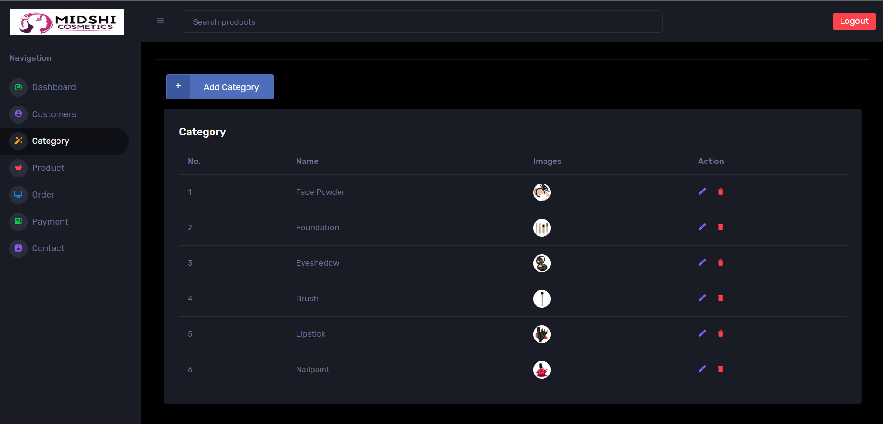
Category

Slide 32
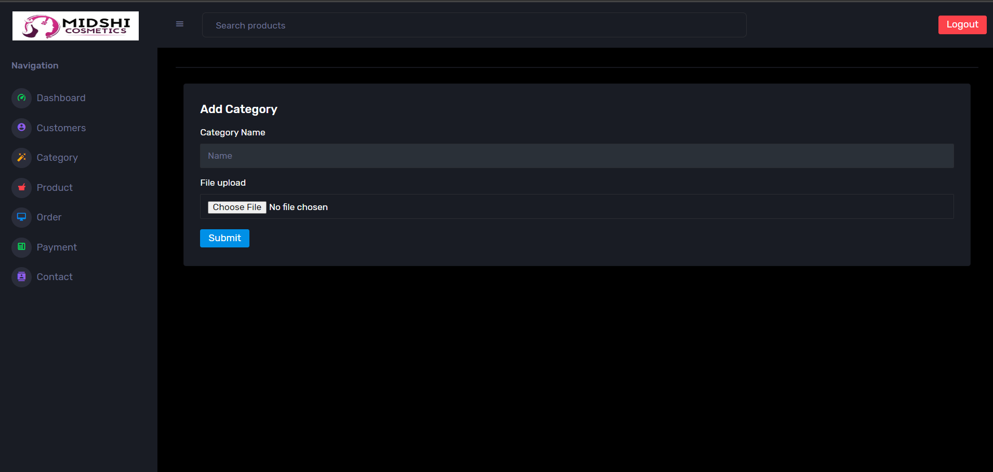
Add Category

Slide 33
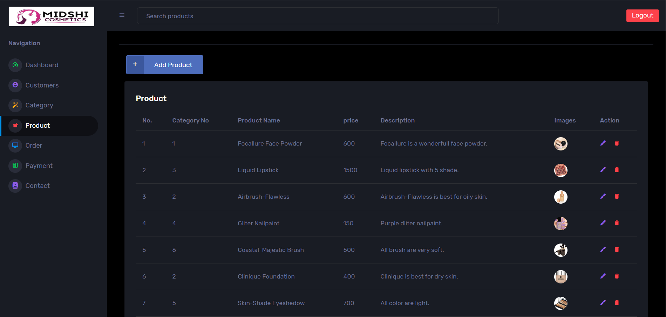
Product

Slide 34
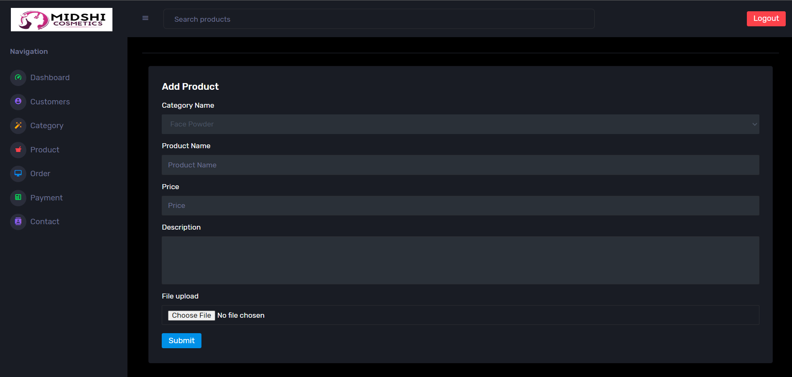
Add Product

Slide 35
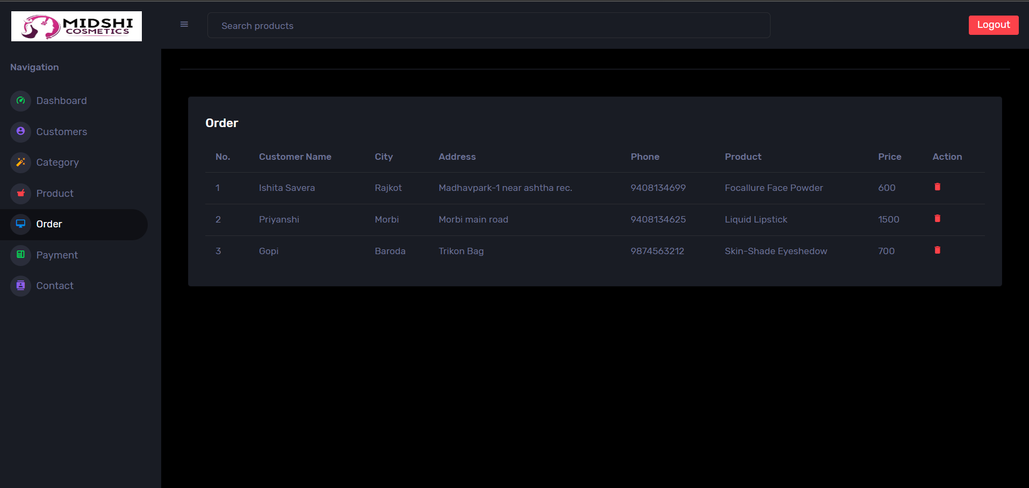
Order

Slide 36
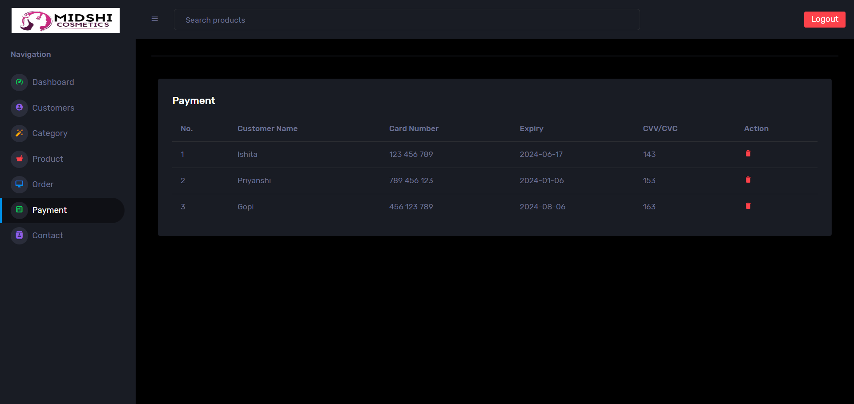
Payment

Slide 37
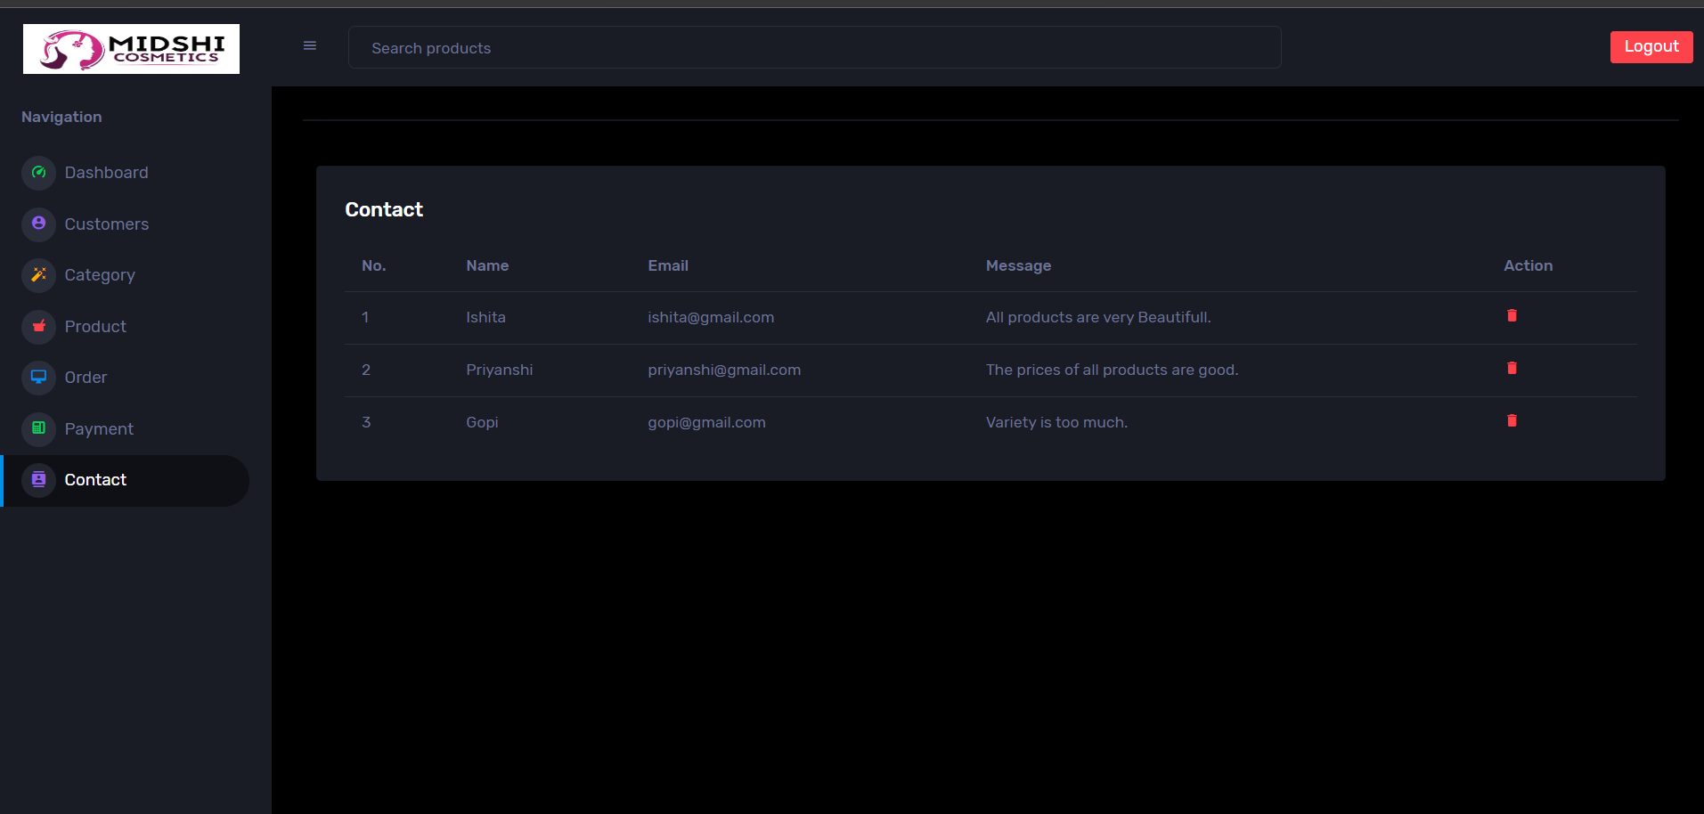
Contact

Slide 38

Websites
https://www.free-css.com
https://themewagon.com/themes/corona-free-responsive-bootstrap-4-admin-dashboard-template
https://www.img2go.com/result#j=41e0242a-2b33-4f73-a4b0-48543c34ec05

Slide 39
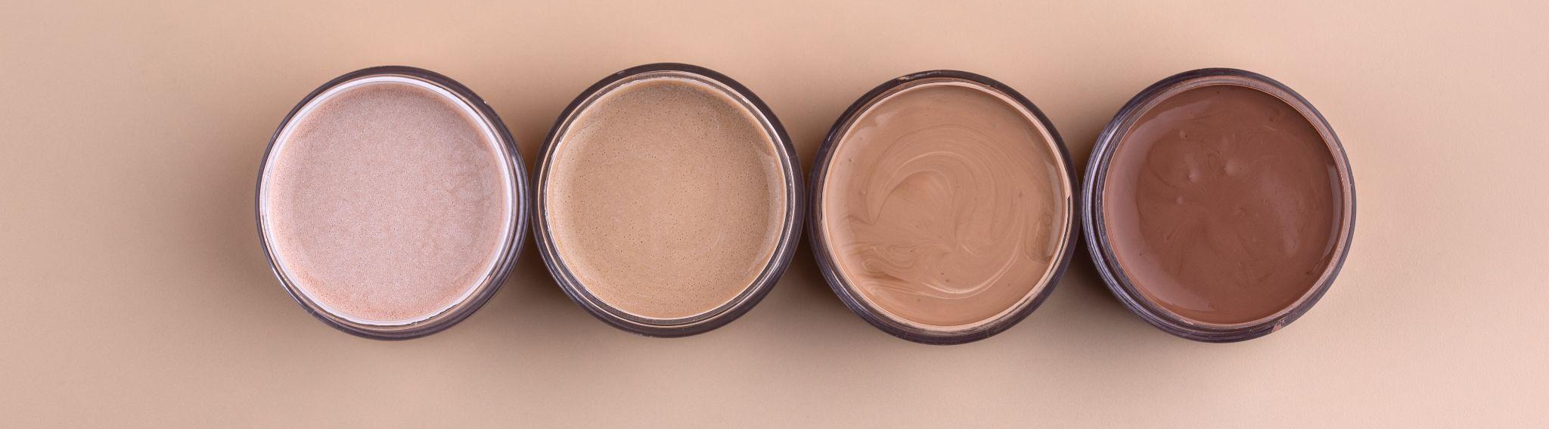
Thank You !

